Slide 1
The New Normal Hackathon
Sub – theme: New Normal

Slide 2
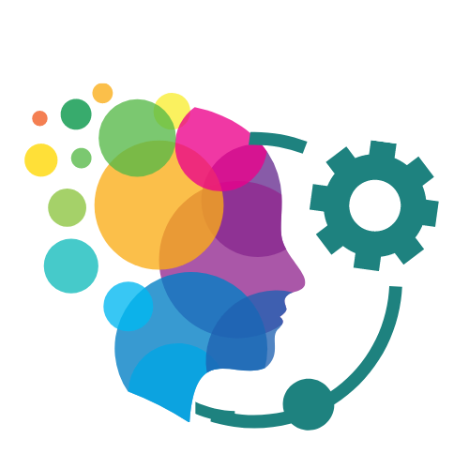
TechLiv
Balancing Technology and Life

Slide 4
Our digital lives
Due to social distancing norms and nationwide lockdowns, the Covid-19 pandemic has inevitably resulted in an increase in the use of digital technologies, particularly our mobile phones.
We are so engrossed in mobile apps, whether games, social media, or others, that we lose track of time.
Our digital activity increases as we use more applications. Applications are designed to make us more reliant (and even addicted) to them.

Slide 5
The Problem
With the outbreak of the pandemic, our digital lives have become unbalanced.

Slide 6
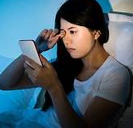
Impact on physical health
Eyestrain
Poor posture
Reduced physical activity
Sleeping problems
Musculo-skeletal problems
Obesity

Slide 7
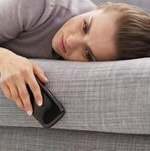
Impact on mental health
Depression
Anxiety
Stress
Insecurity
Restlessness
Addiction
Decreased attention span

Slide 8
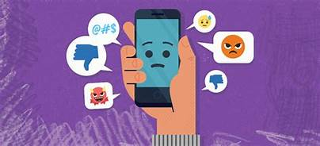
Impact on social health
Decreased self esteem
Hampers people’s quality time with friends and family
Isolation
Increased comparison
Rise of disinformation
Cyberbullying
7 in 10 young people experience cyberbullying before they hit the age of 18.

Slide 9
Current available solutions
Parental Control
Screen Time
App Timers
Dashboard
Do Not Disturb Mode
Browser extensions that block ads
The above solutions mainly focus on the applications, while the solution proposal mainly focuses on the individual users.

Slide 10
Solution proposal
TechLiv
TechLiv
An android application that optimizes your mobile digital behaviour by: -
Visualizing your overall well being
Categorizing your digital identities
Empowering you by setting your goals
Letting you define what is healthy for you
Regulating your digital presence
TechLiv will be an app that will restore digital balance in your life!

Slide 12
The app
App name and logo (Splash Screen displays for few seconds)
Login / Sign Up
Home Page
Goals Settings page
Digital Health Score page
Change Avatar page
About Us page

Slide 13
Key features of the app
Goals Settings page
-> User can choose between 4 categories of apps and set the goals for that particular category
- Financial
- Productivity
- Social
- Entertainment
Digital Health Score page
-> Displays activity chart showing the percentage of the different categories chosen above as per the time spent on each category
-> Displays which application was used maximum by the user
-> Displays which fields need to be improved by the user
Change Avatar page
-> User can choose between many avatars
About Us page
-> Displays information about what the app aims to achieve

Slide 14
Goals Settings Page The users can set their goals as per their convenience. Accordingly, TechLiv monitors if the usage of the applications increases beyond the set thresholds.
Goals settings
Financial
Productivity
Social
Entertainment

Slide 15
Digital Health Score Page The chart shows the statistics of usage of apps. The total hrs spent on apps since the last login, total apps used and the app used maximum by the user are displayed on the screen.
Digital Health Score
Entertainment
Financial
500 hrs
Productivity
20 apps
Social
Avatar icon
Udemy
At the bottom of the screen, the app displays which categories
have exceeded their thresholds and need improvement in terms
of usage

Slide 16
Change Avatar Page Users can change their avatars’ icon
Choose Avatar
?
👦
👧
👨
👩

Slide 17
About Us Page Displaying information on what the app aims to achieve
About Us

Slide 18
TechLiv will be built with
Java
Firebase
TechLiv will be an android app (Nearly 90% of smartphones in the world use Android)

Slide 19

TechLiv will help millions of people all across the globe live healthy lives

Slide 20
TechLiv aims to restore balance in a technology – driven life
Life
Technology
50%
50%

Slide 21
The Future
TechLiv aspires to build a future wherein technology and human lives coexist in a seamless manner, so that human health is not harmed by the negative effects of excessive usage of mobile applications.

Slide 22
Thank You

